Slide 1
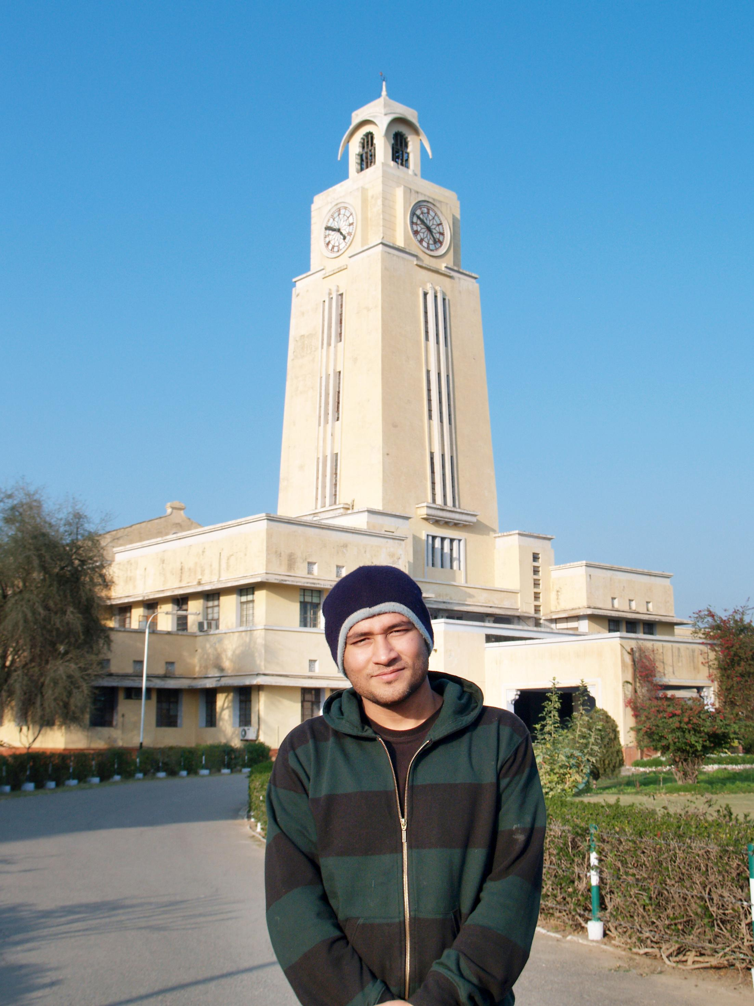

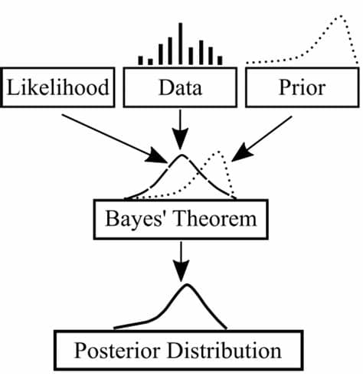

BITS Pilani
Pilani Campus
(some slides adapted from Stuart http://aima.cs.berkeley.edu/)
DSE CL 557 - Artificial and Computational Intelligence
#12. Probabilistic Representation and Reasoning
Sunday, December 20, 2020
Dr. Saikishor Jangiti

Slide 2
Today
Probabilistic Representation and Reasoning
Inference using full joint distribution & Example
Uncertainty
Probability
Syntax and Semantics
Inference
Independence and Bayes' Rule
Knowledge representation using Bayesian Networks, semantics of Bayesian Networks
Reference: Chapter 13, 14.1 & 14.2 from AI: A modern approach (Russell, Norvig)

Slide 3
Uncertainty
Let action A_{t} = leave for airport t minutes before flight
Will A_{t} get me there on time?
Problems:
partial observability (road state, other drivers' plans, etc.)
noisy sensors (traffic reports)
uncertainty in action outcomes (flat tire, etc.)
immense complexity of modeling and predicting traffic
Hence a purely logical approach either
risks falsehood: “A₂₅ will get me there on time”, or
leads to conclusions that are too weak for decision making:
“A₂₅ will get me there on time if there's no accident on the bridge and it doesn't rain and my tires remain intact etc.”
(A₁₄₄₀ might reasonably be said to get me there on time but I'd have to stay overnight in the airport …)

Slide 4
Methods for handling uncertainty
Default or nonmonotonic logic:
Assume my car does not have a flat tire
Assume A₂₅ works unless contradicted by evidence
Issues: What assumptions are reasonable? How to handle contradiction?
Rules with fudge factors:
A₂₅ |→_{0.3} get there on time
Sprinkler |→ _{0.99} WetGrass
WetGrass |→ _{0.7} Rain
Issues: Problems with combination, e.g., Sprinkler causes Rain??
Probability
Model agent's degree of belief
Given the available evidence,
A₂₅ will get me there on time with probability 0.04

Slide 5
Probability
Probabilistic assertions summarize effects of
laziness: failure to enumerate exceptions, qualifications, etc.
ignorance: lack of relevant facts, initial conditions, etc.
Subjective probability:
Probabilities relate propositions to agent's own state of knowledge
e.g., P(A₂₅ | no reported accidents) = 0.06
These are not assertions about the world
Probabilities of propositions change with new evidence:
e.g., P(A₂₅ | no reported accidents, 5 a.m.) = 0.15

Slide 6
Making decisions under uncertainty
Suppose I believe the following:
P(A₂₅ gets me there on time | …) = 0.04
P(A₉₀ gets me there on time | …) = 0.70
P(A₁₂₀ gets me there on time | …) = 0.95
P(A₁₄₄₀ gets me there on time | …) = 0.9999
Which action to choose? Depends on my preferences for missing flight vs. time spent waiting, etc.
Utility theory is used to represent and infer preferences
Decision theory = probability theory + utility theory

Slide 7
Syntax
Basic element: random variable
Similar to propositional logic: possible worlds defined by assignment of values to random variables.
Boolean random variables
e.g., Cavity (do I have a cavity?)
Discrete random variables
e.g., Weather is one of <sunny,rainy,cloudy,snow>
Domain values must be exhaustive and mutually exclusive
Elementary proposition constructed by assignment of a value to a random variable: e.g., Weather = sunny, Cavity = false (abbreviated as ¬cavity)
Complex propositions formed from elementary propositions and standard logical connectives e.g., Weather = sunny ∨ Cavity = false

Slide 8
Syntax
Atomic event: A complete specification of the state of the world about which the agent is uncertain
E.g., if the world consists of only two Boolean variables Cavity and Toothache, then there are 4 distinct atomic events:
Cavity = false ∧Toothache = false
Cavity = false ∧ Toothache = true
Cavity = true ∧ Toothache = false
Cavity = true ∧ Toothache = true
Atomic events are mutually exclusive and exhaustive

Slide 9
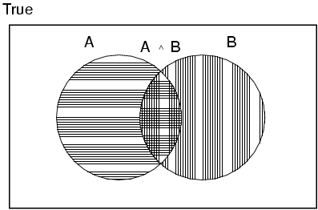
Axioms of probability
For any propositions A, B
0 ≤ P(A) ≤ 1
P(true) = 1 and P(false) = 0
P(A ∨ B) = P(A) + P(B) - P(A ∧ B)

Slide 10
Prior probability
Prior or unconditional probabilities of propositions
e.g., P(Cavity = true) = 0.1 and P(Weather = sunny) = 0.72 correspond to belief prior to arrival of any (new) evidence
Probability distribution gives values for all possible assignments:
P(Weather) = <0.72,0.1,0.08,0.1> (normalized, i.e., sums to 1)
Joint probability distribution for a set of random variables gives the probability of every atomic event on those random variables
P(Weather,Cavity) = a 4 × 2 matrix of values:
Weather = sunny rainy cloudy snow
Cavity = true 0.144 0.02 0.016 0.02
Cavity = false 0.576 0.08 0.064 0.08
Every question about a domain can be answered by the joint distribution

Slide 11
Conditional probability
Conditional or posterior probabilities
e.g., P(cavity | toothache) = 0.8
i.e., given that toothache is all I know
(Notation for conditional distributions:
P(Cavity | Toothache) = 2-element vector of 2-element vectors)
If we know more, e.g., cavity is also given, then we have
P(cavity | toothache, cavity) = 1
New evidence may be irrelevant, allowing simplification, e.g.,
P(cavity | toothache, sunny) = P(cavity | toothache) = 0.8
This kind of inference, sanctioned by domain knowledge, is crucial

Slide 12
Conditional probability
Definition of conditional probability:
P(a | b) = P(a ∧ b) / P(b) if P(b) > 0
Product rule gives an alternative formulation:
P(a ∧ b) = P(a | b) P(b) = P(b | a) P(a)
A general version holds for whole distributions, e.g.,
P(Weather, Cavity) = P(Weather | Cavity) P(Cavity)
(View as a set of 4 × 2 equations, not matrix mult.)
Chain rule is derived by successive application of product rule:
P(X₁, …,X_{n}) = P(X₁,...,X_{n-1}) P(X_{n} | X₁,...,X_{n-1})
= P(X₁,...,X_{n-2}) P(X_{n-1} | X₁,...,X_{n-2}) P(X_{n} | X₁,...,X_{n-1})
= …
= π_{i= 1}^n P(X_{i} | X₁, … ,X_{i-1})

Slide 13

Inference by enumeration
Start with the joint probability distribution:
For any proposition φ, sum the atomic events where it is true: P(φ) = Σ_{ω:ω╞φ} P(ω)

Slide 14

Inference by enumeration
Start with the joint probability distribution:
For any proposition φ, sum the atomic events where it is true: P(φ) = Σ_{ω:ω╞φ} P(ω)
P(toothache) = 0.108 + 0.012 + 0.016 + 0.064 = 0.2

Slide 15

Inference by enumeration
Start with the joint probability distribution:
For any proposition φ, sum the atomic events where it is true: P(φ) = Σ_{ω:ω╞φ} P(ω)
P(toothache) = 0.108 + 0.012 + 0.016 + 0.064 = 0.2

Slide 16

Inference by enumeration
Start with the joint probability distribution:
Can also compute conditional probabilities:
P(¬cavity | toothache) = P(¬cavity ∧ toothache)
P(toothache)
= 0.016+0.064
0.108 + 0.012 + 0.016 + 0.064
= 0.4

Slide 17
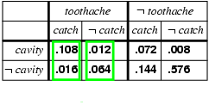
Normalization
Denominator can be viewed as a normalization constant α
P(Cavity | toothache) = α, P(Cavity,toothache)
= α, [P(Cavity,toothache,catch) + P(Cavity,toothache,¬ catch)]
= α, [<0.108,0.016> + <0.012,0.064>]
= α, <0.12,0.08> = <0.6,0.4>
General idea: compute distribution on query variable by fixing evidence variables and summing over hidden variables

Slide 18
Inference by enumeration, contd.
Typically, we are interested in
the posterior joint distribution of the query variables Y
given specific values e for the evidence variables E
Let the hidden variables be H = X - Y - E
Then the required summation of joint entries is done by summing out the hidden variables:
P(Y | E = e) = αP(Y,E = e) = αΣ_{h}P(Y,E= e, H = h)
The terms in the summation are joint entries because Y, E and H together exhaust the set of random variables
Obvious problems:
Worst-case time complexity O(d^{n}) where d is the largest arity
Space complexity O(d^{n}) to store the joint distribution
How to find the numbers for O(d^{n}) entries?

Slide 19
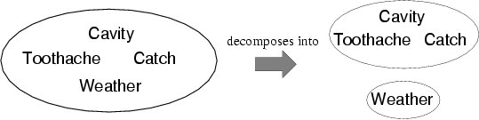
Independence
A and B are independent iff
P(A|B) = P(A) or P(B|A) = P(B) or P(A, B) = P(A) P(B)
P(Toothache, Catch, Cavity, Weather)
= P(Toothache, Catch, Cavity) P(Weather)
32 entries reduced to 12; for n independent biased coins, O(2^{n}) →O(n)
Absolute independence powerful but rare
Dentistry is a large field with hundreds of variables, none of which are independent. What to do?

Slide 20
Conditional independence
P(Toothache, Cavity, Catch) has 2³ – 1 = 7 independent entries
If I have a cavity, the probability that the probe catches in it doesn't depend on whether I have a toothache:
(1) P(catch | toothache, cavity) = P(catch | cavity)
The same independence holds if I haven't got a cavity:
(2) P(catch | toothache,¬cavity) = P(catch | ¬cavity)
Catch is conditionally independent of Toothache given Cavity:
P(Catch | Toothache,Cavity) = P(Catch | Cavity)
Equivalent statements:
P(Toothache | Catch, Cavity) = P(Toothache | Cavity)
P(Toothache, Catch | Cavity) = P(Toothache | Cavity) P(Catch | Cavity)

Slide 21
Conditional independence contd.
Write out full joint distribution using chain rule:
P(Toothache, Catch, Cavity)
= P(Toothache | Catch, Cavity) P(Catch, Cavity)
= P(Toothache | Catch, Cavity) P(Catch | Cavity) P(Cavity)
= P(Toothache | Cavity) P(Catch | Cavity) P(Cavity)
I.e., 2 + 2 + 1 = 5 independent numbers
In most cases, the use of conditional independence reduces the size of the representation of the joint distribution from exponential in n to linear in n.
Conditional independence is our most basic and robust form of knowledge about uncertain environments.

Slide 22
Bayes' Rule
Product rule P(a∧b) = P(a | b) P(b) = P(b | a) P(a)
⇒ Bayes' rule: P(a | b) = P(b | a) P(a) / P(b)
or in distribution form
P(Y|X) = P(X|Y) P(Y) / P(X) = αP(X|Y) P(Y)
Useful for assessing diagnostic probability from causal probability:
P(Cause|Effect) = P(Effect|Cause) P(Cause) / P(Effect)
E.g., let M be meningitis, S be stiff neck:
P(m|s) = P(s|m) P(m) / P(s) = 0.8 × 0.0001 / 0.1 = 0.0008
Note: posterior probability of meningitis still very small!

Slide 23
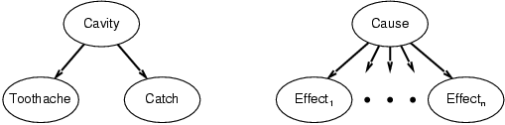
Bayes' Rule and conditional independence
P(Cavity | toothache ∧ catch)
= αP(toothache ∧ catch | Cavity) P(Cavity)
= αP(toothache | Cavity) P(catch | Cavity) P(Cavity)
This is an example of a naïve Bayes model:
P(Cause,Effect₁, … ,Effect_{n}) = P(Cause) π_{i}P(Effect_{i}|Cause)
Total number of parameters is linear in n

Slide 24
Summary
Probability is a rigorous formalism for uncertain knowledge
Joint probability distribution specifies probability of every atomic event
Queries can be answered by summing over atomic events
For nontrivial domains, we must find a way to reduce the joint size
Independence and conditional independence provide the tools

Slide 25
Knowledge representation using Bayesian Networks, semantics of Bayesian Networks

Slide 26
Outline
Syntax
Semantics

Slide 27
Bayesian networks
A simple, graphical notation for conditional independence assertions and hence for compact specification of full joint distributions
Syntax:
a set of nodes, one per variable
a directed, acyclic graph (link ≈ "directly influences")
a conditional distribution for each node given its parents:
P (X_{i} | Parents (X_{i}))
In the simplest case, conditional distribution represented as a conditional probability table (CPT) giving the distribution over X_{i} for each combination of parent values

Slide 28
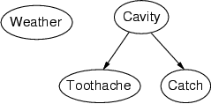
Example
Topology of network encodes conditional independence assertions:
Weather is independent of the other variables
Toothache and Catch are conditionally independent given Cavity

Slide 29
Example
I'm at work, neighbor John calls to say my alarm is ringing, but neighbor Mary doesn't call. Sometimes it's set off by minor earthquakes. Is there a burglar?
Variables: Burglary, Earthquake, Alarm, JohnCalls, MaryCalls
Network topology reflects "causal" knowledge:
A burglar can set the alarm off
An earthquake can set the alarm off
The alarm can cause Mary to call
The alarm can cause John to call

Slide 30
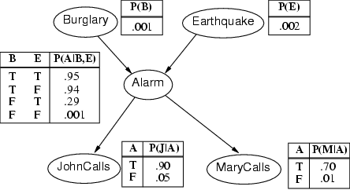
Example contd.

Slide 31
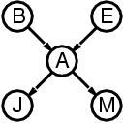
Compactness
A CPT for Boolean X_{i} with k Boolean parents has 2^{k} rows for the combinations of parent values
Each row requires one number p for X_{i} = true (the number for X_{i} = false is just 1-p)
If each variable has no more than k parents, the complete network requires O(n · 2^{k}) numbers
I.e., grows linearly with n, vs. O(2^{n}) for the full joint distribution
For burglary net, 1 + 1 + 4 + 2 + 2 = 10 numbers (vs. 2⁵-1 = 31)

Slide 32
Semantics
The full joint distribution is defined as the product of the local conditional distributions:
P (X₁, … ,X_{n}) = π_{i = 1} P (X_{i} | Parents(X_{i}))
e.g., P(j ∧ m ∧ a ∧ ¬b ∧ ¬e)
= P (j | a) P (m | a) P (a | ¬b, ¬e) P (¬b) P (¬e)

Slide 33
Thank you for your Attention
Any more queries

